Slide 1


Slide 2
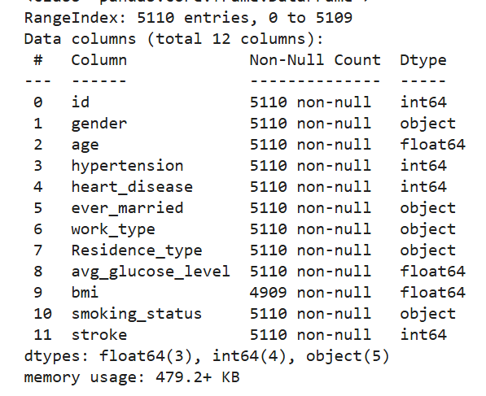
Raw Dataset.
12 columns.
With a total of 5110 entries.
Obs: Column numbers are 12 but the last one is 11, because in python lists starts in 0.

Slide 3
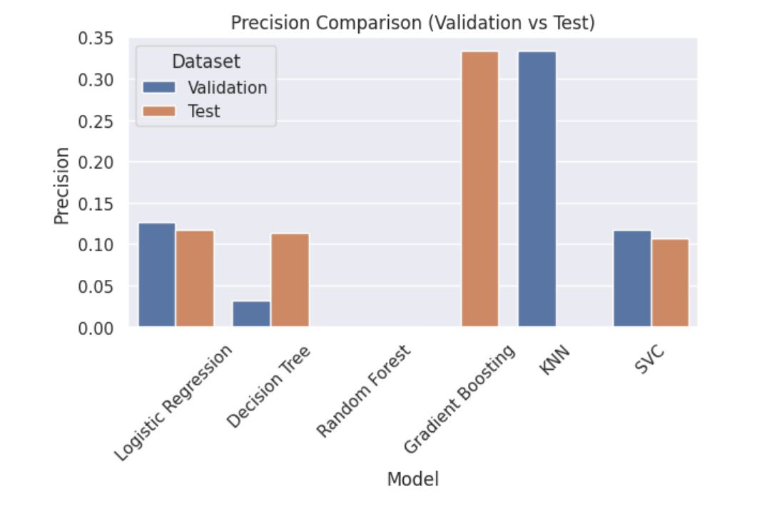
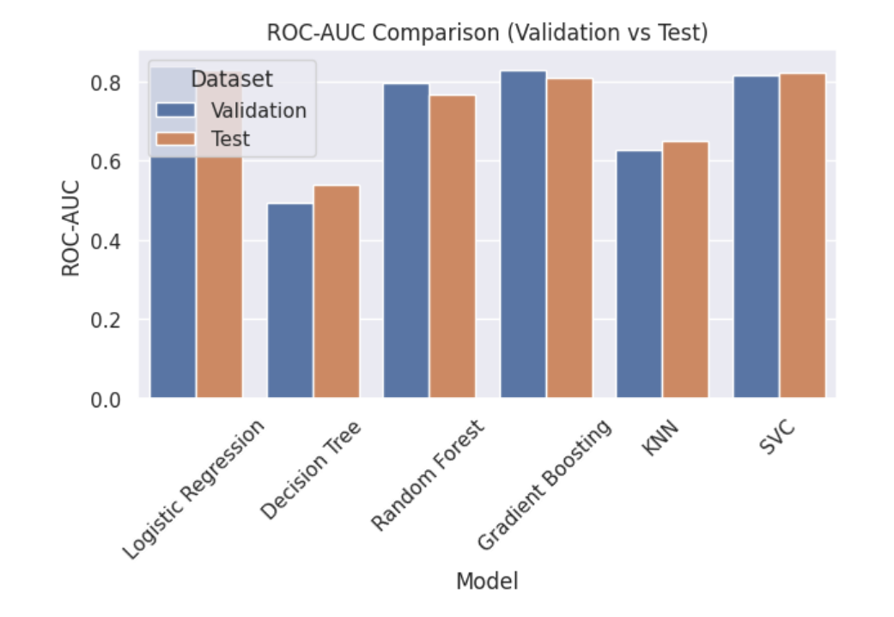
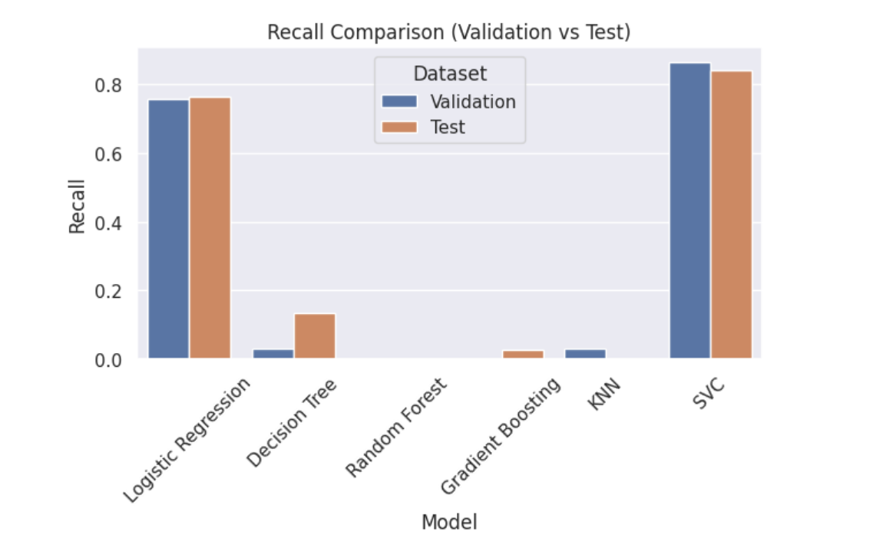
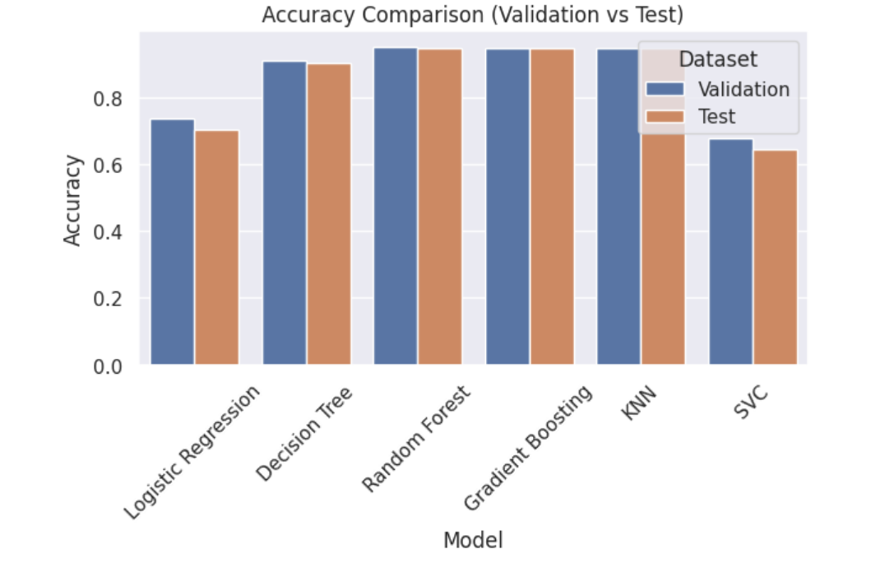
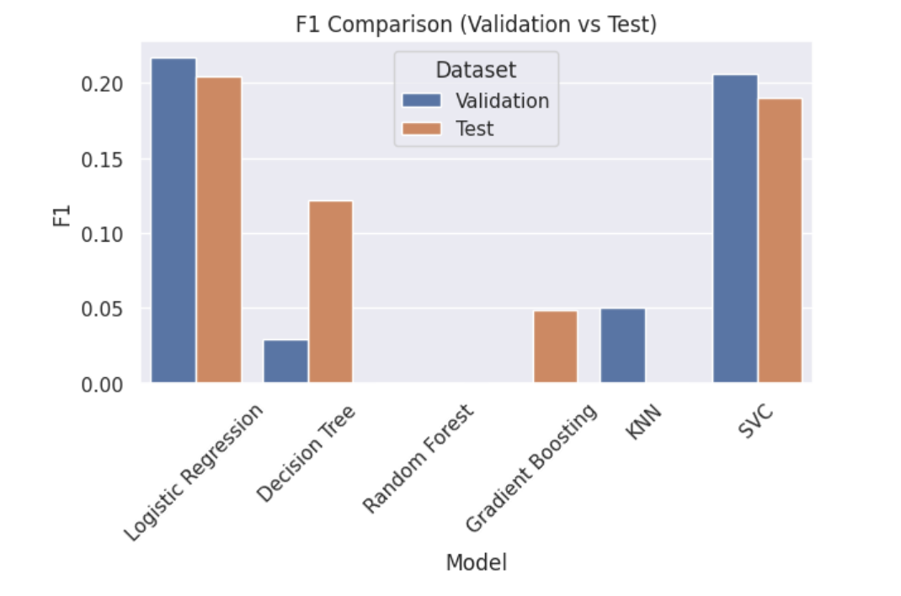
Validation VS Test
These graphs compare the performance of different machine learning models on validation and test datasets using metrics like precision, recall, accuracy, F1 score, and ROC-AUC to evaluate how well each model predicts stroke risk.

Slide 4
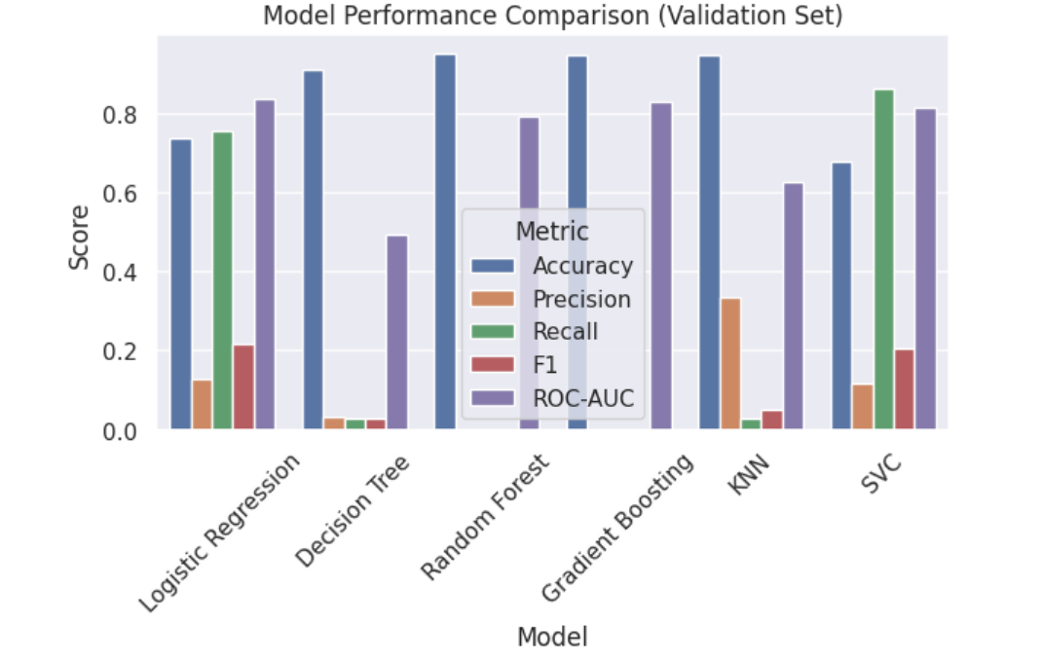
Final Analyses.
Even though some models showed very high accuracy, they are not useful because they fail to detect positive cases. The best individual model is Logistic Regression because, it has a good balance between metrics, detects positive cases better and performs consistently.
Obs: SVC is also a strong model, especially for recall.
The ensemble model is the best overall because it combines multiple models and gives more reliable results.

Slide 5
Thank You

